Slide 1
POTENTIOMETERS
GROUP 4
BARAKA BEN
KAHELO EUNICE MONICA 230242417582
LUJE ISSA SHABAN

Slide 2
Potentiometer
Is an instrument used for measuring potential difference or electromotive force by performing a comparison with a known voltage
A standard cell or any other known voltage reference source can be used for comparison
The accuracy of the measurements does not on the actual deflection of a pointer but upon the accuracy of the known voltage of the reference source

Slide 3
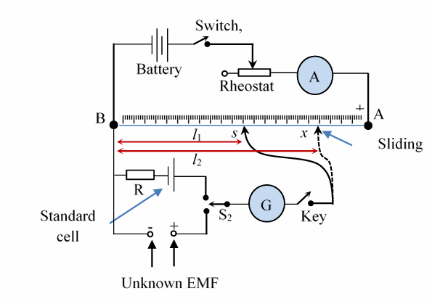
Construction of a basic potentiometer

Slide 4
Instruments used in basic potentiometer
resistor R is used to protect the standard cell against excessive current flow.
A galvanometer is used to detect a null point.
A standard cell is a reference voltage source with a known and stable EMF
Unknow EMF is the voltage source whose EMF you want to measure
A rheostat is an adjustable resistor that allows you to vary the current flowing through the potentiometer circuit
The sliding contact, or wiper, is a movable contact that slides along the resistive element of the potentiometer
The battery provides the energy needed to drive the circuit.
The switch is used to control the flow of current in the circuit
An ammeter is used to measure the current flowing through the circuit.

Slide 5
Working principle of a basic potentiometer
Initially, the sliding contact is set in the mid of the slide wire.
Then press the switch, S1 to complete the auxiliary circuit.
Adjust the rheostat to obtain the constant current through the potentiometer wire.
The potentiometer is calibrated by connecting the standard cell to the galvanometer through switch, S.
Now, move the sliding contact on the slide wire, until a position s is reached when the galvanometer shows zero deflection.
Once the galvanometer shows zero current, measure the length of the potentiometer wire between the sliding contact and the end where the known voltage (standard cell) is connected. Let’s call this length L1.
Now, connect the unknown EMF to the galvanometer through the switch, and move the sliding contact on the slide wire, until the galvanometer shows zero deflection. Let’s call it L2

Slide 6
Mathematical expression
L2/​E_{unknown}​​=L1/​_{Estandard​​}
Where:
E_{unknown}_is the unknown EMF.
L2_ is the length of wire corresponding to the unknown EMF.
E_{standard}_is the known EMF of the standard reference source.
L1_is the length of wire corresponding to the standard cell’s EMF.

Slide 7
Types of potentiometer
They are two types of potentiometer
Laboratory type potentiometer
Modern potentiometer

Slide 8
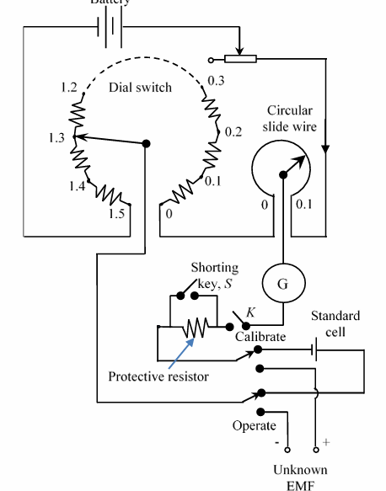
Laboratory type potentiometer

Slide 9
laboratory-type potentiometer
Laboratory-type potentiometer has one dial switch with fifteen steps, each having a precision resistor of 10 Ω and a single 10 Ω turn circular slide wire
The circular slide wire has 200 divisions corresponding to the resolution of 0.5 mV.
A double-throw switch is provided for calibration and measuring the unknown EMF.
A protective resistance is connected in series with the galvanometer to protect the galvanometer and is shorted when the galvanometer reaches the balanced condition.
The working current of the potentiometer provided by the battery is 10 mA, then each step of the dial switch corresponds to 0.1 V.

Slide 10
Operation of laboratory-type potentiometer
Supposing the value of EMF of the standard cell is 1.0186 V, first calibrate the potentiometer by adjusting the dial switch at 1.0 V and slide wire at 0.0186.
The double-throw switch is set to the calibrated position to connect the standard cell and galvanometer to the dial switch and slide wire.
Adjust the rheostat until the galvanometer shows null deflection.
Close the shorting key, S, when the rheostat is adjusted until the galvanometer shows null deflection
Set the double-throw switch to operate-position to connect the unknown EMF to the potentiometer circuit.

Slide 11
With the protective resistance in the circuit, balance the potentiometer (galvanometer reads zero point) by adjusting the main dial and the slide wire.
When the potentiometer is approaching the balance point, the protective resistance is shorted, and final adjustments are made to obtain true balance.
Now, the value of the unknown EMF is read off directly measured from the dial switch and circular slide wire.
This method has better precision than using a basic potentiometer.

Slide 12
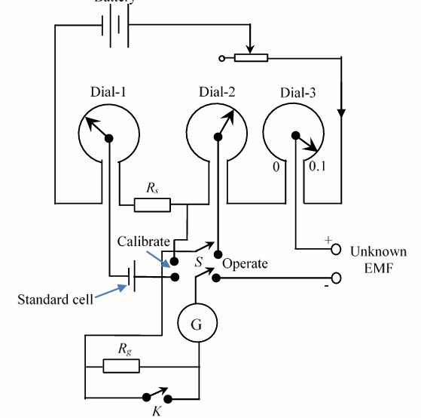
Modern Potentiometer

Slide 13
Modern potentiometer
Modern potentiometer consist of a separate or independent standard cell dial circuit comprised of a standard cell, standard resistor R, and dial-1. This separate standard cell dial circuit enables operators to check the standard cell balance during measurements without disturbing the potentiometer settings.
This independent standardizing circuit can be set on any range of standard cell EMF from 1.016 V to 1.020 V.
A drop of 1.016 V is provided by resistance, Rs and the remaining drop of 0.004 V is provided by the slide-1.
The protective resistance and shorting key are used to protect the galvanometer.

Slide 14
Initially, the slide-1 is set to read the EMF of the standard cell.
The selector switch S, Double Pole Double Throw (DPDT), is set to calibrate position and the rheostat is adjusted to balance the galvanometer.
This fixes the working current to its proper value.
The switch S is then thrown to the operate position and unknown EMF is read by adjusting the dial-2 and dial-3.
The standardizing circuit can be checked for the consistency of working current, anytime during the measurements by simply throwing the switch S back to calibrate position.
This process does not disturb the measuring circuit. Besides it is convenient and increases the speed of measurements.

